Slide 1


Unit 1 Service Standards and Service Development Lecture 1-2 Raw Services and Self-Hosting
CSE 446/598 Software Integration and Engineering
Dr. Yinong Chen
https://myasucourses.asu.edu/

Slide 2
Lecture Outline
WCF Basic Service Development and Consuming (Review)
Raw Service Development and Self-Hosting
Raw Service development: Develop the interface without using the service tools
Host (worker process) development
Endpoint creation
Proxy creation
Different Clients Consuming Self-Hosting Services

Slide 3
Model of Service-Oriented Software Development
Three-Party Development Model
The Rest of Chapters
Service brokers
This Chapter
Registry
Registry
Application builders
Service providers
Applications
Active objects

Slide 4
Service/Application Development Environments
ASP.NET and Windows Communication Foundation (WCF) (Textbook Chapter 3)
Workflow Foundation (Text Chapter 7)
Oracle SOA Suite/ JDeveloper (Text Chapter 8)
Java-based SOA Development: Netbeans, Eclipse/Axis/Tomcat
JAX-RPC 1.1 API
J2EE
BEA WebLogic
IBM WebSphere
SAP Enterprise Service Architecture (ESA) Development Framework

Slide 5
WCF Service Development and Consuming
ASP .Net is a component in Visual Studio for service and application development.
It can be used for service development (.asmx service)
It is mainly used for application development
WCF is a component in Visual Studio
WCF is used for service development only (.svc service)
It is used for developing SOAP as well as RESTful services
WCF service hosting: with or without IIS
Service Interfaces: Both .asmx and .svc services use WSDL
WCF service consuming
Console application
ASP .Net Windows forms application (Desktop application)
ASP .Net Website (Web application) / HTML5 Website
Workflow Foundation
BPEL, and many others
Different at programming language level

Slide 6



WCF Interface between Client and Service
WCF Service.svc
WCF Client
Endpoint
A
B
C
Proxy
Endpoint
C
B
A
A
B
C
Endpoint
A
B
C
Address
(where)
Proxy to Endpoint
Binding
(how)
Please read text section 3.1 for more detail
Contract
(what)

Slide 7
Endpoint Coded in WSDL
An ASP .Net endpoint is the port to the method exposed through a markup of contract in program
WCF endpoint contains ABC:
The two types of endpoints (.asmx and.svc) have different structures, but contain the same basic information
Both are coded in WSDL
definitions
service
ASP .Net endpoint
port
(URL)
binding
(soap)
Address
(where)
WCF endpoint
Binding
(how)
portType
operation
Contract
(what)
message, in
type
message, out
type

Slide 8
Developing WCF Basic Services & Clients
Developing a Service using WCF tools (Review)
Developing a WCF service using template
Hosting the service using IIS Express Server
Developing a console application to consume the WCF service
Developing WCF Service with Self-Hosting

Slide 9
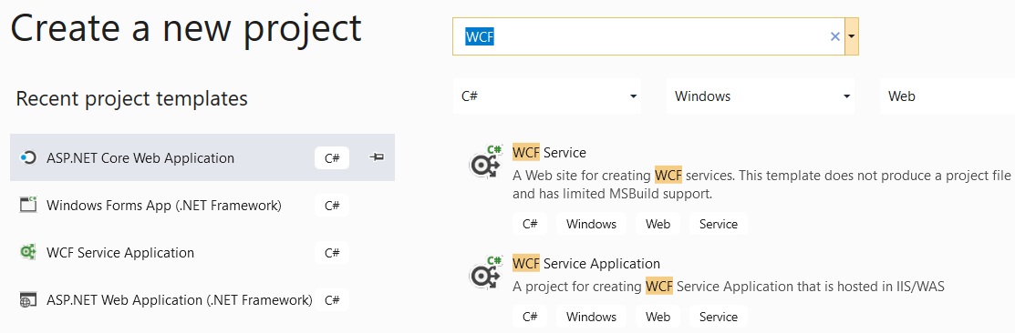
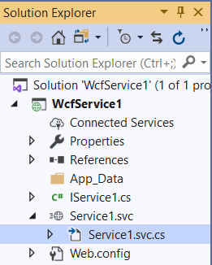
Develop Web Services Using WCF
Text Chapter 3, section 3.2.1
We did this exercise in CSE445 Assignment 1

Slide 10
Step 2: Define Service Contract / Interface
1
interface
// IService.cs file
using System.ServiceModel;
[ServiceContract]
public interface IService {
[OperationContract]
string GetData(int value); // generated code, rename it
// TODO: Add your service operation contracts here
[OperationContract]
double PiValue(); // my operation 1
[OperationContract]
int absValue(int intVal); // my operation 2
}

Slide 11
Step 3: Implement Service Contract (behavior)
2
// Service.svc.cs file
using System.ServiceModel;
public class Service : Iservice {
public string GetData(int value) {
return string.Format("You entered: {0}", value);
}
public double PiValue() {
double pi = System.Math.PI;
return (pi);
}
public int absValue(int x) {
if (x >= 0) return (x);
else return (-x);
}
}
interface
Service implementation
(behavior)

Slide 12
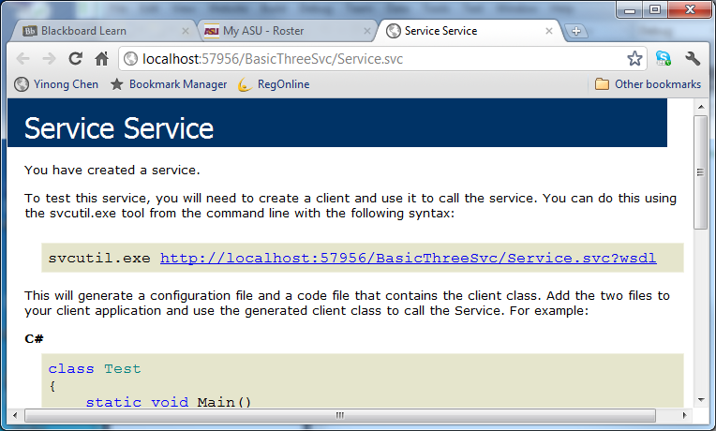
Step 4: Build and View in Browser
Right-click file Service.svc and choose “View in Browser”
The service is hosted in a localhost / IIS Express
You cannot test a WCF service in the Web browser. You must create a client program.
Click on the link: http://localhost:57956/BasicThreeSvc/Service.svc?wsdl To view the WSDL file

Slide 13
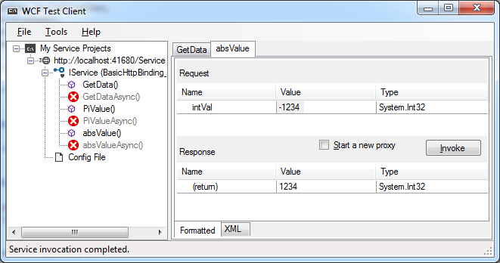
Built-in Test Client
Read text for other ways of starting the Test Client: From CMD
Select the service
Menu: DEBUG → Start Without Debugging
The Test Client Window will be open:

Slide 14
Hosting Using Localhost / IIS Express
Interoperable Services
WSDL-Based
Standard Interface
interface
Service implementation
(behavior)
Hosting Service in
Localhost / IIS Express

Slide 15
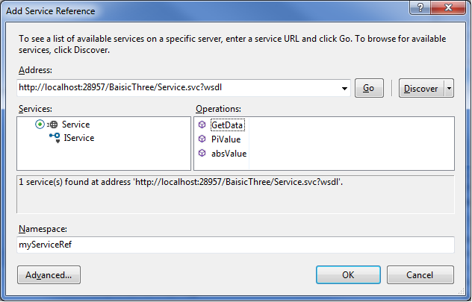
Step 5: Create a Client to Test the Service
Add a Console Application into the same solution
Add Service Reference:
http://localhost:28957/BaisicThree/Service.svc?wsdl
Rename to myServiceRef
Please read text section 3.6.4 for more detail

Slide 16
Step 6: Write Client Code to Invoke Service
static void Main(string[] args) { // console application
myServiceRef.ServiceClient myProxy = new myServiceRef.ServiceClient();
double pi = myProxy.PiValue(); // call PiValue operation
Int32 test1 = 27; // Create test input 1
Int32 test2 = -132; // Create test input 2
Int32 result1 = myProxy.absValue(test1); // call operation
Int32 result2 = myProxy.absValue(test2); // call operation
Console.WriteLine("PI value = {0}", pi);
Console.WriteLine("Absolute values of {0} is {1} and of {2} is {3}", test1, result1, test2, result2);
Console.WriteLine("GetData = {0}", myProxy.GetData(1234));
// Close the proxy, the channel to the service
myProxy.Close();
}

Slide 17
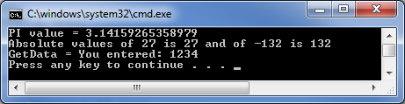
Step 7: Test the WCF Client and Service
First, start the service by right-click the Service.svc and choose “View in Browser” → Keep service running
Right-click the client project and choose: Set as StartUp Project
Start without Debugging

Slide 18
Developing Self-Hosting Services and Clients
WCF Basic Service Development (Review)
The process is largely automated
Developing a Raw Service and Self-Hosting
Developing raw service without using template tools;
Developing the hosting service;
Creating endpoint and proxy
Consuming the service in a command line client;
Consuming the service in ASP .Net website

Slide 19
Different Ways of Hosting WCF Services
Internet
.Net
Localhost / IIS Express
IIS
Server
Self-
Hosting
Cloud
Server
Reduced
overhead;
Increased
flexibility
Increased scalability in software & hardware
CSE445

Slide 20
Reasons of Using Self-Hosting
Self-
Hosting
Reduced overhead for efficiency
IIS (Internet Information Services) and WAS (Windows Process Activation Services) are designed to deal with all possible scenarios of service hosting
Self-hosting can avoid many overheads
Increased flexibility/controllability
IIS and WAS decide when a service is open (started) and closed (terminated).
With self-hosting, you can decide when to start and when to close a service.

Slide 21
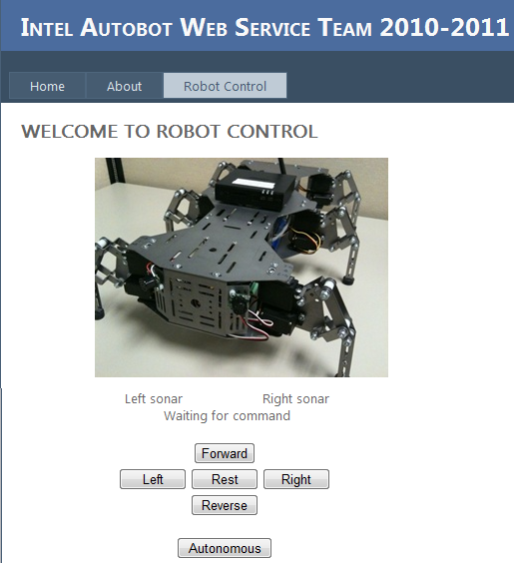


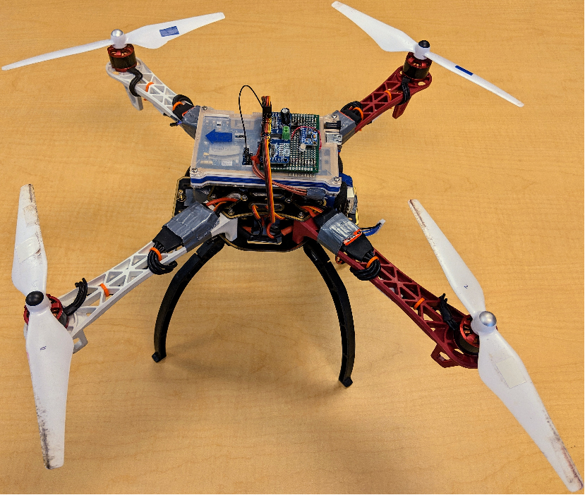

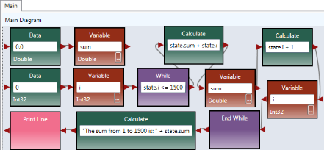
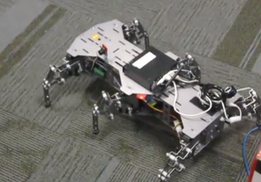


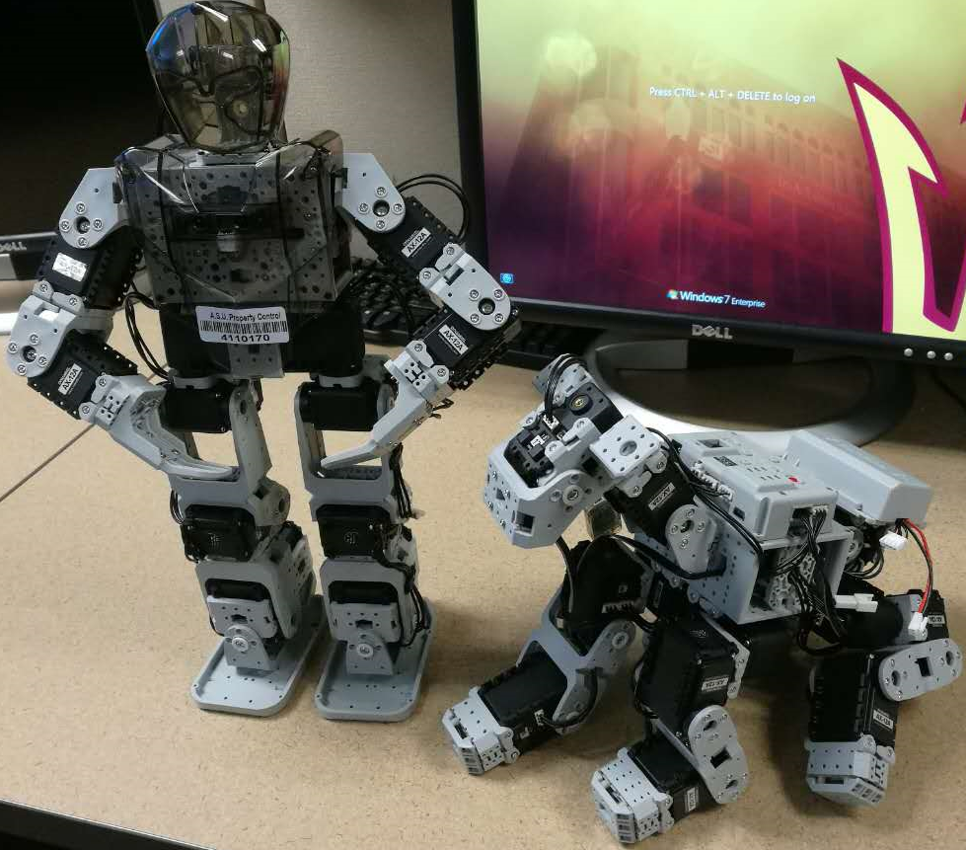


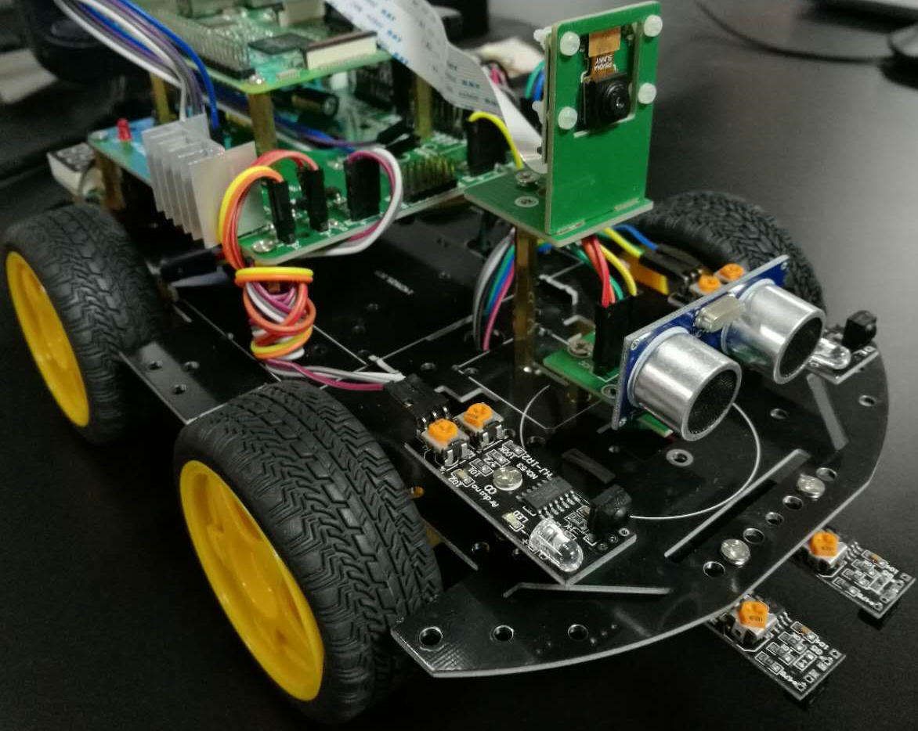


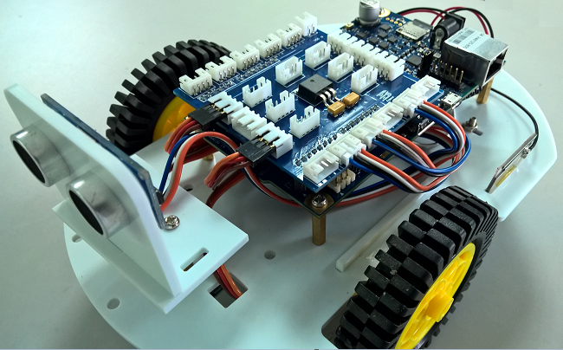



Case Study of Using Self-Hosting Service for IoT and Robotics Apps
http://neptune.fulton.ad.asu.edu/WSRepository/apps/RaaS/main/
Web Simulation Environment
Visual IoT/Robotics Programming Language Environment
http://neptune.fulton.ad.asu.edu/VIPLE/
TORCS
Physical Quadrotor
Traffic Simulator
BIOLOID
Unity Simulator
Raspberry Pi
Robot as a Service at ASU,
with self-hosting service
Web 3D Simulator
Raspberry Pi Robot
Web 2D Simulator
Intel Galileo Robot
Intel Edison Robot
pcDuino Robot
Lego EV3

Slide 22
Self-Hosting Using Multithreading
Write your own Worker process, which can run in an infinite loop, or until a condition is met;
Write your service methods
Worker process activates each service method as a thread – active object (design pattern)
Without implementing service management, one client can call the service at a time;
To implement multiple accesses at the same time, implement service queue, as discussed in Text chapter 2.

Slide 23
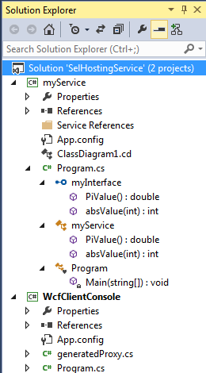
Self-Hosting Project Overview
Service Solution: SelfhostingService namespace WcfServiceConsole
Client Solution
Service Interface
public interface myInterface
Client project
Endpoint
A
B
C
Proxy
Endpoint
C
B
A
A
B
C
Service Implementation
public class myService : myInterface
Main class
class Program {
static void Main(string[] args)

Slide 24
Developing Services with Self-Hosting
Reading: Text Section 7.1
Start Visual Studio as an administrator: right-clicking the program in the Start menu and selecting “Run as administrator”; It is necessary as the service needs to register an HTTP channel for client to access;
Create a new Solution, with a new Project of Console Application type and name the service “myService”;
Create Contract Through Interface;
Implement the service behavior in C#
Adding Hosting Service and Endpoint

Slide 25
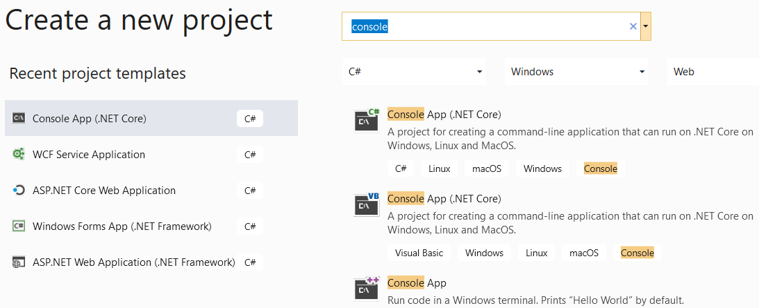
Starting a New Solution of Console Application Type We use console application to create a service
Console application is a basic template without advanced tools

Slide 26
Service Code in the Console Application: Interface and Implementation
using System;
using System.ServiceModel;
using System.ServiceModel.Description;
namespace WcfServiceConsole {
[ServiceContract]
public interface myInterface { // Use interface to define contracts
[OperationContract] double PiValue();
[OperationContract] int absValue(int intVal);
}
public class myService : myInterface // implementation of interface
{ public double PiValue() {
double pi = System.Math.PI; return (pi);
}
public int absValue(int x) {
if (x >= 0) return (x); else return (-x);
}
} // not yet complete, to add hosting code next
Service Contract is based on interface definition
Operation Contract is based on method
Implementation
interface
Service implementation
(behavior)

Slide 27
Project Overview
Service Solution: SelfhostingService namespace WcfServiceConsole
Client Solution
Service Interface
public interface myInterface
Client project
Endpoint
A
B
C
Proxy
Endpoint
C
B
A
A
B
C
Service Implementation
public class myService : myInterface
Main class
class Program {
static void Main(string[] args)

Slide 28
Create Hosting Service and Endpoint
In the Console Application, add in the Main method;
1. Using Uri library class to create a URI instance to myService as the base address;
Uri baseAddress = new Uri("http://localhost:8000/Service");
Create a new ServiceHost
instance to host the service
ServiceHost selfHost = new
ServiceHost(typeof(myService),
baseAddress);
interface
Address
Service implementation
(behavior)
Contract
Service name
Self-Hosting
Service
Base address included

Slide 29
Create Hosting Service and Endpoint
Add contract (myInterface) and Binding (WsHttpBinding)
selfHost.AddServiceEndpoint(typeof(myInterface),
new WsHttpBinding(),
"myService");
Contract
binding
interface
behavior
Address
Service implementation
(behavior)
Endpoint
Binding
Contract
Self-Hosting
Service

Slide 30
Adding HTTP GET for Public Access
4. Add metadata for public access
System.ServiceModel.Description.ServiceMetadataBehavior smb = new System.ServiceModel.Description.ServiceMetadataBehavior( );
smb.HttpGetEnabled = true;
selfHost.Description.Behaviors.Add(smb);
ServiceMetadataBehavior
(HTTP GET)
A different class in the namespace System.ServiceModel.Description will result in a different interface for a different kind of clients to access.
As both SOAP/WSDL services and RESTful services use HTTP GET, the interface can potentially support both types of services.
interface
Address
Service implementation
(behavior)
Binding
Contract
Endpoint
Self-Hosting
Service

Slide 31
Public Properties of ServiceMetadataBehavior Class
Property Name | Description
ExternalMetadataLocation | Gets or sets a value that is the location of service metadata
HttpGetEnabled | Gets or sets a value that indicates whether to publish service metadata for retrieval using an HTTP/GET request.
HttpGetUrl | Gets or sets the location of metadata publication for HTTP/GET requests.
HttpsGetEnabled | Gets or sets a value that indicates whether to publish service metadata for retrieval using an HTTPS/GET request.
HttpsGetUrl | Gets or sets the location of metadata publication for HTTPS/GET requests.
MetadataExporter | Gets or sets the internal MetadataExporter object used to publish the service metadata.

Slide 32
Starting and Terminating the Service
5. Start service and waiting for request.
selfHost.Open();
6. Close the ServiceHostBase to shutdown the service.
selfHost.Close();
ServiceMetadataBehavior
(WSDL)
interface
Address
.Open
Service implementation
(behavior)
Binding
Contract
.Close
Endpoint
Self-Hosting
Service

Slide 33
Code Together: Hosting Part
class Program { // more detail see text section 7.1
static void Main(string[] args) {
// (1) Create a URI instance to myService as the base address.
Uri baseAddress = new Uri("http://localhost:8000/Service");
// (2) Create a new ServiceHost instance to host the service
ServiceHost selfHost = new ServiceHost
(typeof(myService),
baseAddress); // (3) Add contract
try {
// (4) Add binding
selfHost.AddServiceEndpoint(
typeof(myInterface),
new WSHttpBinding(),
"myService");
interface
Address
Service implementation
(behavior)
Binding
Contract
Self-Hosting
Service

Slide 34
Service Code: Hosting Part
// (4) Add metadata for public access.
System.ServiceModel.Description.ServiceMetadataBehavior smb =
new System.ServiceModel.Description.ServiceMetadataBehavior( );
smb.HttpGetEnabled = true;
selfHost.Description.Behaviors.Add(smb);
// (5) Start the service and waiting for request.
selfHost.Open();
Console.WriteLine("myService developed in WCF is ready to take requests. Please create a client to call my double PiValue() service or int absValue(int) service.");
Console.WriteLine("If you want to quit this service, simply press <ENTER>.\n");
Console.ReadLine();
// (6) Close the ServiceHostBase to shutdown the service.
selfHost.Close();
}}}}
Without (4), the service will be .Net - .Net remoting!

Slide 35
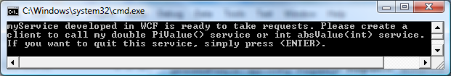
Starting the Service
The service is fully developed and we can start the service in Visual Studio by executing the command “Start without Debugging”.
You could also add and edit the endpoint by editing the Web.config file: http://msdn.microsoft.com/en-us/library/ms734786(v=vs.110).aspx

Slide 36
Project Overview: Service and Client
Service Solution: namespace WcfServiceConsole
Service Interface
public interface myInterface
Console Application
Endpoint
A
B
C
Endpoint
Proxy
A
B
C
C
B
A
Service Implementation
public class myService : myInterface
Main class
class Program {
static void Main(string[] args)

Slide 37
Client to Consume Self-Hosting Service in a Console Application
Add a new Console Application in the same solution where the self-hosting project resides;
Right-click to add Reference: System.ServiceModel under Assemblies → framework (It may have been added already in the newer version of VS)
Generate proxy to the service;
The service is not hosted in IIS nor in IIS Express server;
If the proxy cannot be generated by using “Add Service Reference” in your programming environment, follow the next page:

Slide 38
Creating the Proxy to Self-Hosting Service
Generate the proxy based on the metadata published by the service.
Use the Service Model Metadata Utility Tool (SvcUtil.exe) tool to generate the proxy.
Independent tool
Generating
Proxy
ServiceMetadataBehavior
(WSDL)
SvcUtil.exe
Client
interface
A
Address
.Open
generated
Proxy.cs
Service implementation
(behavior)
B
Binding
C
Contract
.Close
app.config
Endpoint
Self-Hosting
Service

Slide 39
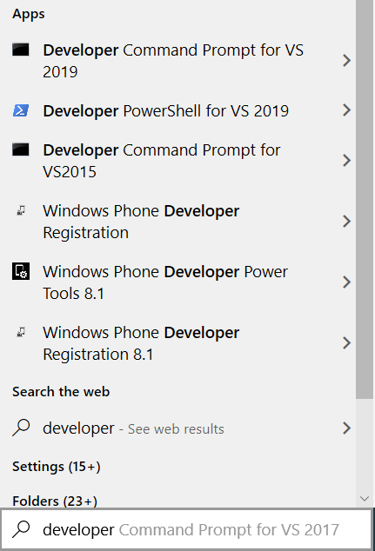
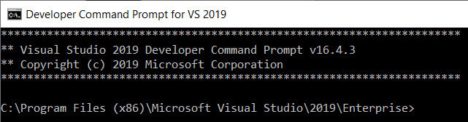
Use SvcUtil.exe Tool to Generate the Proxy
https://docs.microsoft.com/en-us/dotnet/framework/tools/developer-command-prompt-for-vs

Slide 40
Use SvcUtil.exe Tool to Generate the Proxy
https://docs.microsoft.com/en-us/dotnet/framework/tools/developer-command-prompt-for-vs
If necessary, use DOS commands “dir”, “cd ..” and “cd folder” to navigate into the directory where you have your client project is created in the previous step.
Keep your Service running and type the following command to execute:
svcutil.exe /language:cs /out:generatedProxy.cs /config:app.config http://localhost:8000/Service
This command will generate two files: app.config and generatedProxy.cs, and place them into the directory: C:\Windows\System32 or Search for them.

Slide 41
Use SvcUtil.exe Tool to Generate the Proxy
Copy the two files generatedProxy.cs and app.config into you client project directory, and then add them into your client project: Right-click the client project in Solution Explorer, select Add → Existing Item. Browse to the location of generatedProxy.cs to add.
Repeat the step above to add the app.config configuration file: By default, the Add Existing Item dialog box filters out all files with a .config extension. To see these files select All Files (*.*) in the file type.
Also read: Developer Command Prompt for Visual Studio https://msdn.microsoft.com/en-us/library/ms229859(v=vs.110).aspx

Slide 42
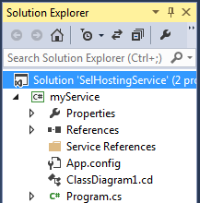
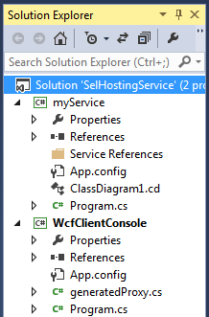
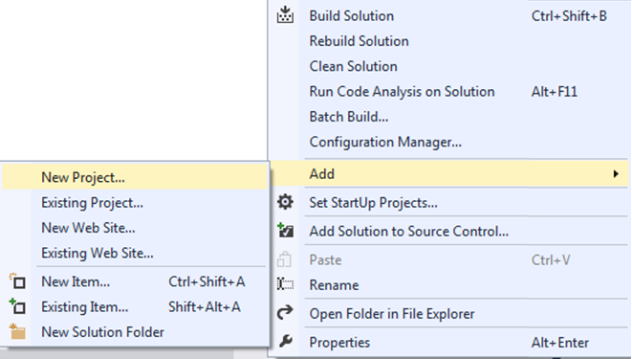
Add the Two Generated Files into Client
New files added to the project

Slide 43
appl.config File
<?xml version="1.0" encoding="utf-8"?>
<configuration>
<system.serviceModel>
<bindings>
<wsHttpBinding>
<binding name="WSHttpBinding_myInterface"
closeTimeout="00:01:00" openTimeout="00:01:00"
receiveTimeout="00:10:00" sendTimeout="00:01:00"
bypassProxyOnLocal="false" transactionFlow="false"
hostNameComparisonMode="StrongWildcard"
maxBufferPoolSize="524288"
maxReceivedMessageSize="65536"
messageEncoding="Text" textEncoding="utf-8"
useDefaultWebProxy="true"
allowCookies="false">
<readerQuotas maxDepth="32" maxStringContentLength="8192"
maxArrayLength="16384" maxBytesPerRead="4096"
maxNameTableCharCount="16384" />
<reliableSession ordered="true" inactivityTimeout="00:10:00“ enabled="false" />
Editing these default values

Slide 44
appl.config File
<security mode="Message">
<transport clientCredentialType="Windows"
proxyCredentialType="None" realm="" />
<message clientCredentialType="Windows"
negotiateServiceCredential="true"
algorithmSuite="Default" establishSecurityContext="true" />
</security>
</binding>
</wsHttpBinding>
</bindings>
<client>
<endpoint address= "http://localhost:8000/Service/myService"
binding="wsHttpBinding" bindingConfiguration="WSHttpBinding_myInterface"
contract="myInterface" name="WSHttpBinding_myInterface">
<identity> <userPrincipalName value="YinongBYENG\yinong" /> </identity>
</endpoint>
</client>
</system.serviceModel>
</configuration>

Slide 45
Client Program in Console Application
class Program {
static void Main(string[] args) {
//(1) Create a proxy to the WCF service.
myInterfaceClient myProxy = new myInterfaceClient();
// (2) Call the service operations through the proxy
double pi = myProxy.PiValue(); // call PiValue operation
Int32 test1 = 27; // Create test input 1
Int32 test2 = -132; // Create test input 2
Int32 result1 = myProxy.absValue(test1); // call operation
Int32 result2 = myProxy.absValue(test2); // call operation
Console.WriteLine("PI value = {0}", pi);
Console.WriteLine("Absolute values of {0} is {1} and of {2} is {3}", test1, test2, result1, result2);
myProxy.Close(); // (3) Close the proxy & channel to the service
Console.WriteLine("/nPress <ENTER> to terminate the client./n");
}

Slide 46
Test client and self-hosting service
Right click myService project and choose: Set as StartUp Project;
Start the project without debugging;
Right click the project WCFClientConsole and choose Debug → Start new instance.
If the console window closes at the end, you can add Console.ReadLine at the end of the client program to prevent the console to close.
1
3

Slide 47
Use Localhost and ASP .Net GUI Client to Consume Self-Hosting Services
The previous example showed to create the proxy manually, so that you have full control of the proxy. You can also create the proxy automatically using Visual Studio.
Step 1. Add an ASP .Net Web Site into the Self-Hosting Service Solution
Right-click the Solution WcfServiceConsole. Select Add → New → Web Site …
Select ASP .Net Web Site and the project “AspSite”
Start the Service in localhost or in IIS
Add Service Reference
http://localhost:8000/Service/myService

Slide 48
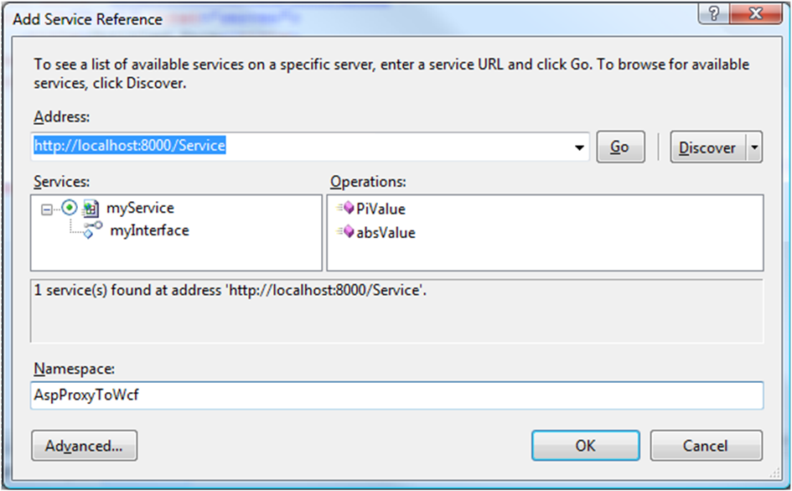
Add Service Reference

Slide 49
C# Code Behind the ASPX Page
using System;
public partial class _Default : System.Web.UI.Page {
protected void Page_Load(object sender, EventArgs e) { }
protected void btnPiValue_Click(object sender, EventArgs e) {
AspProxyToWcf.myInterfaceClient refvar = new AspProxyToWcf.myInterfaceClient();
double pi = refvar.PiValue();
lblPiValue.Text = Convert.ToString(pi);
}
protected void Button1_Click(object sender, EventArgs e) {
AspProxyToWcf.myInterfaceClient refvar = new AspProxyToWcf.myInterfaceClient();
string abstxt = txtAbsoluteValue.Text;
int absVal = refvar.absValue(Convert.ToInt32(abstxt));
lblAbsoluteValue.Text = Convert.ToString(absVal);
}
}

Slide 50
Use ASP .Net GUI Client to Consume Self-Hosting Services

Slide 51
Summary
Developing Basic Service Using WCF Template and Server Hosting
Developing Raw Service without Server Hosting: Self-Hosting
Writing a service without using WCF tools
Writing hosting service without using a server
Creating Proxy without using “Add Service Reference”
Consuming WCF services
In Console Application
In ASP .Net
Many more: WF, BPEL, Cloud Computing, etc.

